Slide 1
ToC Implementation at Infiniti
Project Overview and Business Impact

Slide 2
Background for Project Implementation
Goldratt Consulting (GC) conducted an initial workshop with senior management in Jul’11 with the objective of finding the right levers to improve Profitability and RoI in a sustainable way
As sales and margin were already showing a healthy growth, the focus area identified for action and improvement was inventory
A sample study of the inventory revealed
High levels of shortages in active SKUs - 19%
High levels of overstocking – wrong stock in wrong stores
Long tail .i.e. large no. of SKUs contribution to small % of sales - 75% of SKUs giving only 10% of sales
High levels of obsolete stock – Rs.25 crs of DQ stock

Slide 3
Scope of Project
Phase 1 of implementation focused on managing ‘Depth of Inventory’
Maximizing sales by aggregating stocks at DC and balancing stocks between stores as per sales
Moving to pull-based replenishment has dramatically improved inventory turns thereby freeing up cash previously tied up in inventory
Phase 2 focusing on managing ‘Width of Inventory’
Maximizing sales by improving effectiveness of range at stores
Maintaining flow in the store .i.e. continuous refreshment of range with new products & timely liquidation of non-moving products
Managing Own label supply chain
Phase 3 to focus on managing the declining Gross Margin
Sales Management process to align sales channel to company’s strategic objective
Vendor Negotiation to develop strategic alliances with vendors to achieve better GP

Slide 4
Phase 1 Implementation - Highlights
Pull Replenishment
Automatically align stock to actual demand through Symphony software’s DBM algorithm
Bestsellers Availability
Focus on availability of bestsellers - 10% of SKUs contributing to 50% of company sales
New Product Introduction
Guide investment decision in new products (nearly 200 new SKUs introduced per month) by systematic piloting in select stores before bulk purchases for all stores
Aggregation of stock in DCs reduce instances of stock outs & overstocking at stores
Minimizing loss of sales by constant focus on availability in vendor interactions
Increase in bestsellers availability to c. 90% has improved same stores sales
NPI process tested in Computers whose turns has improved by 35% in last 12 month
Improving success ratio of new lines and limiting investment in non-moving SKUs

Slide 5
Phase 2 Implementation - Highlights
Range Alignment
Customize every store’s range to its customer requirement by using concept of category/price band effectiveness to determine store range
End-of-Life Management
Systematic identification of slow-moving stock to initiate timely liquidation
DC Buying
Aligning buying at DC to store sales using concept of weeks cover
Semi-automated system to prioritize ranging of best performing available SKU in the category/price band to store
Improve Throughput per Sq. ft by improving range performance
Decrease liquidation hit on aged stock & free up shelf space for new SKUs
Additionally an “Open to Buy” budget for each group to provide purchasing flexibility for promotional/deal based buying, seasonal stock build up and protecting availability

Slide 6
Phase 3 – Under Implementation
Vendor Negotiation & Strategic Alliance
Sales Process Management
Performance measures for this process will be improvement in sales, conversion, ticket size and no. of items/invoice
Process to also focus on exploring opportunities for upselling, add-on & cross selling
Evaluate various brands in a category basis performance parameters of turns, margin & GP earned per display space allocated in stores
Identify potential areas for negotiations with brands and create win-win deals with high GP brands
Leverage premium display space in Croma stores to create competition amongst brands for negotiating favorable terms of trade
Create a decision making matrix (based on customer segmentation) to enable sales staff to better understand customer requirement and match with available range to create “Best Value for Customer”
Buying team to tailor the available range to ensure availability of customer choice in every segment

Slide 7
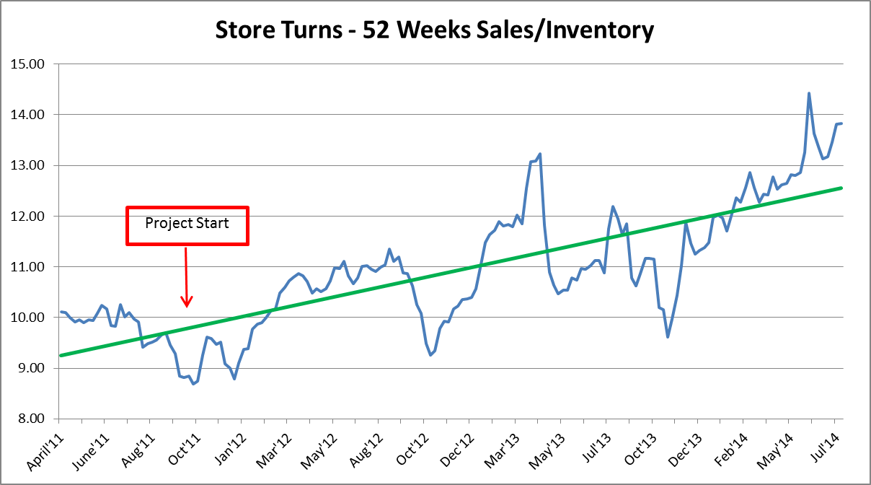
Improvement in Store Turns
Trend in store turns prior to commencement of project was flat
Improvement of 58% in store turns from 8.8x in Oct’11 to 13.9x in July’14
Store turns sustained at 13x for YTD FY15

Slide 8
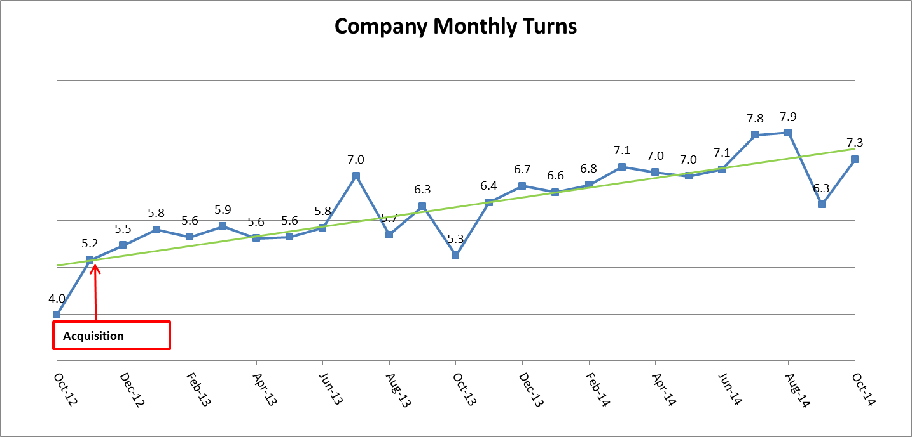
Improvement in Company Turns
Post acquisition of Woolworths Wholesale India, the DC inventory was also managed using ToC principles
Overall company turns has improved by 50% since acquisition of wholesale company in Nov’12

Slide 9
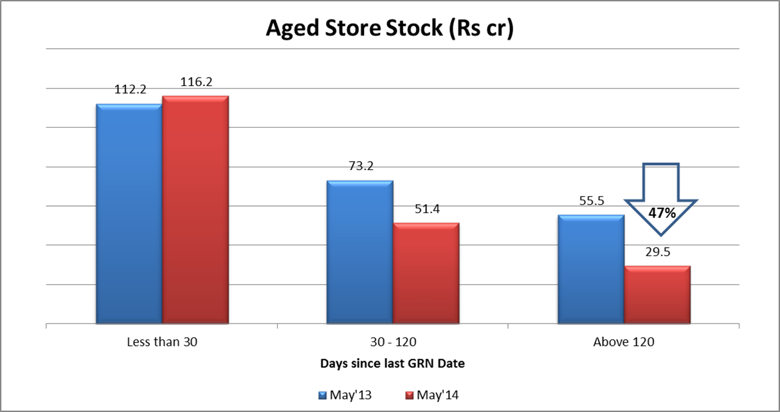
Decrease in Aged Inventory
Pro-active liquidation process has reduced accumulation of aged stock improving the quality of stock
Aged stock to total store stock decreased from 23% in May’13 to 13% in Jul’14
Reduction in aged stocks over 120 days by 60% in LTL stores

Slide 10
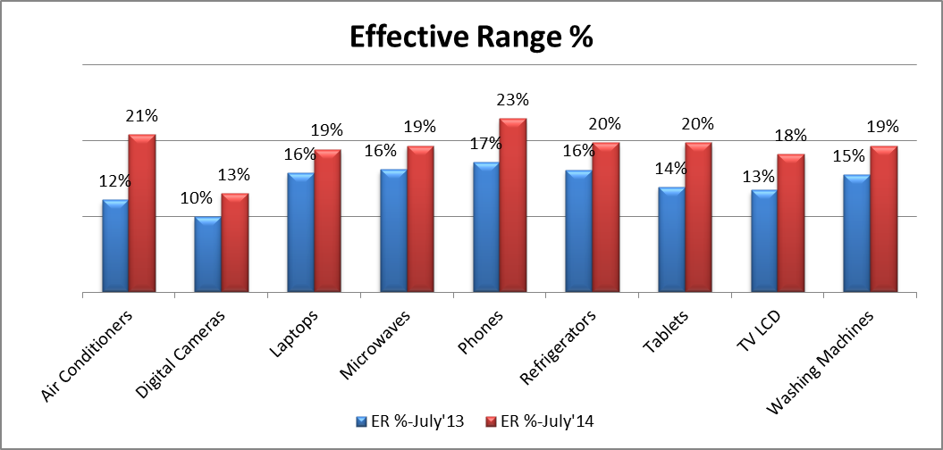
Increase in Effective Range %
30% increase in ER % across main categories indicates improvement in range performance by aligning to catchment demand and cutting-out non-performing range

Slide 11
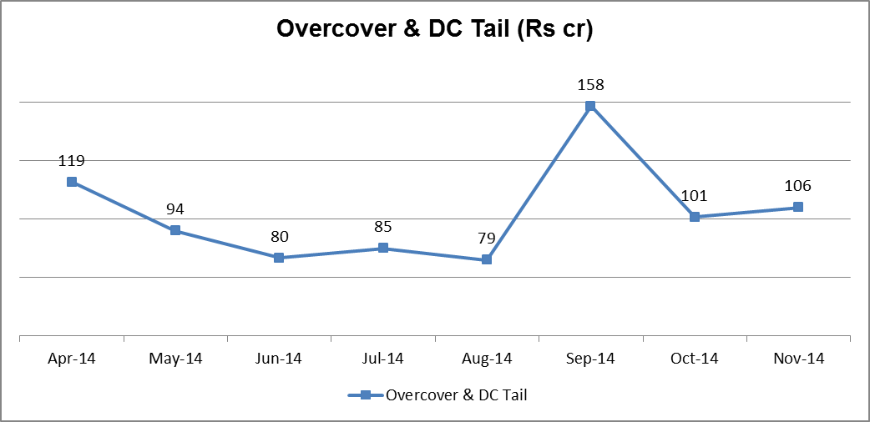
Decrease in Non-Effective Stock
Stock above defined weeks cover provides visibility of potential high-risk inventory
34% decrease in Overcover & DC Tail stock in 5 month period ending Aug’14
Residual stock from Diwali buying impacting non-effective stock in Nov’14

Slide 12
Thank you

